Slide 1




SILICONCHIP TECHNOLOGIES
USER GUIDE

Slide 2
Cadence Tutorial
1. Create Library ................................................................................................................ 3
2. Schematic.......................................................................................................................... 4
A. Create a cell view ........................................................................................................... 4
B. Draw a schematic............................................................................................................ 5
3. Run Spectre simulation .................................................................................................. 10 A. Launch ADE (Analog Design Environment) L.......................................................... 10
4. Layout ............................................................................................................................ 11
A. Create a layout .............................................................................................................. 11
B. Add an instance - nmos ................................................................................................ 12
C. Add more instances – pmos, ptap, ntap, and m1_ploy ............................................. 13
D. Draw metal1 .................................................................................................................. 14
E. Run DRC ....................................................................................................................... 15
F. Add pins........................................................................................................................... 17
G. Extract ........................................................................................................................... 19
H. Run LVS......................................................................................................................... 20
I. Run Spectre simulation ................................................................................................ 21

Slide 3
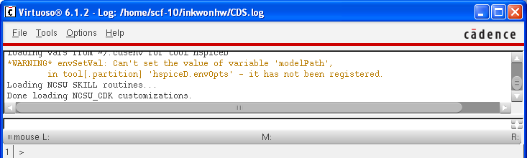
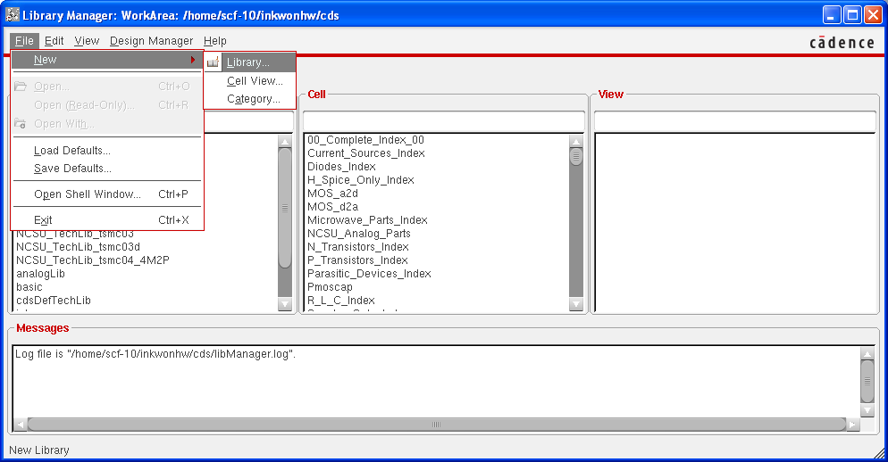
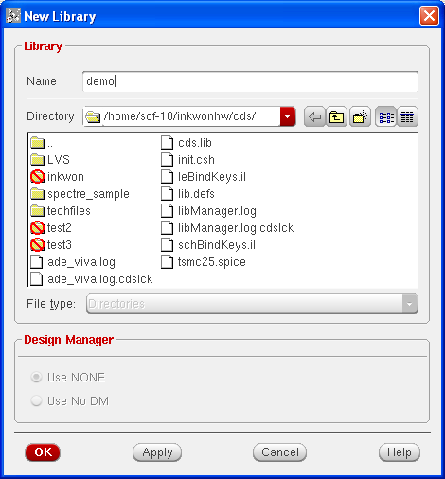
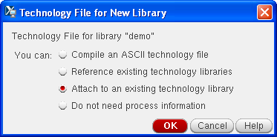
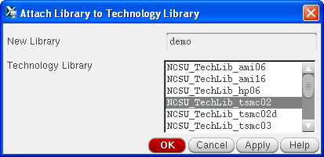
Create Library
A. Tools → Library Manager
B. File → New → Library
C. Give a name and attach it to a technology library

Slide 4
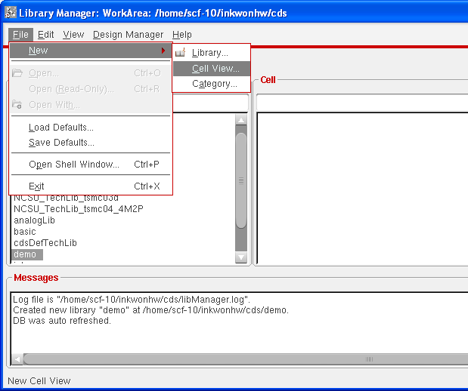
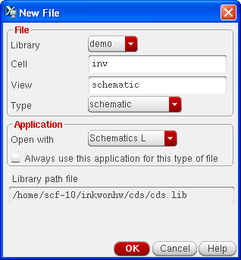
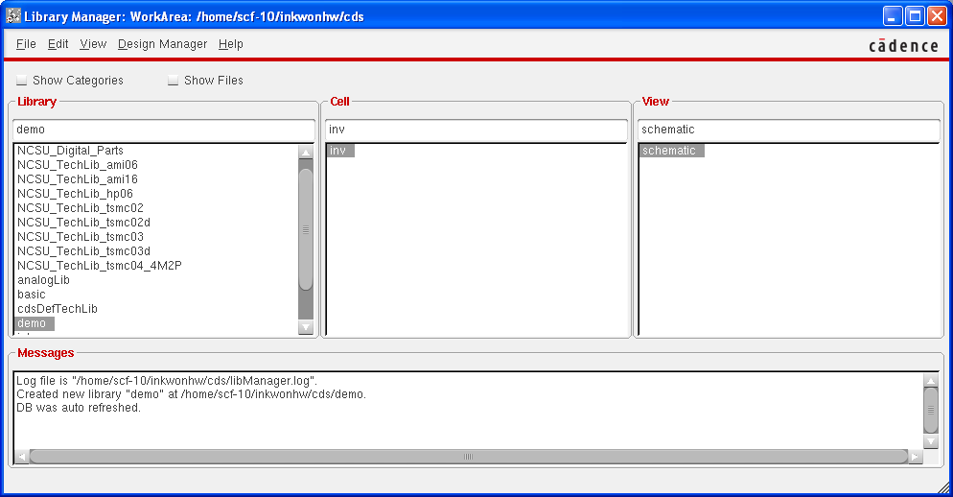
Schematic
A. Create a cell view

Slide 5
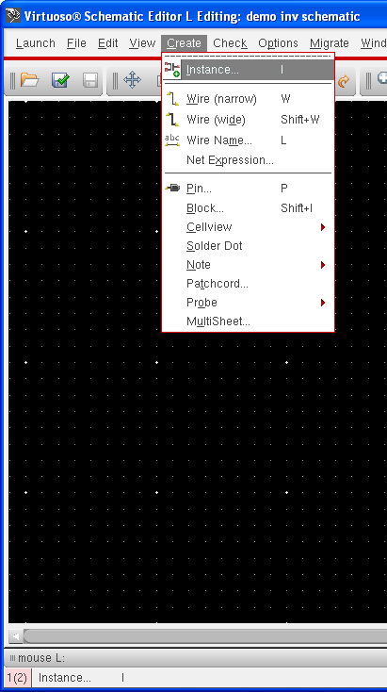
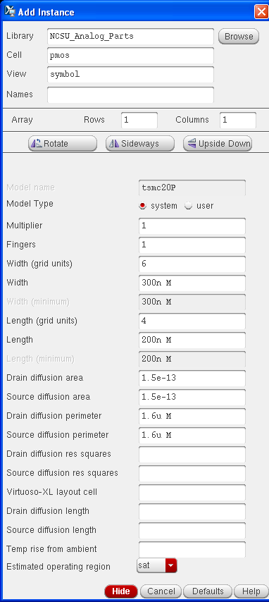
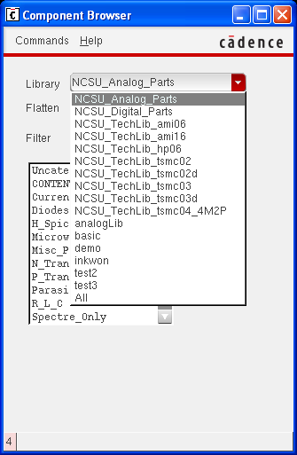
B. Draw a schematic
i. Add instances – pmos
You can modify Width of transistors. Don’t modify length unless you have a special purpose. You should select a NCSU_Analog_Parts library.

Slide 6

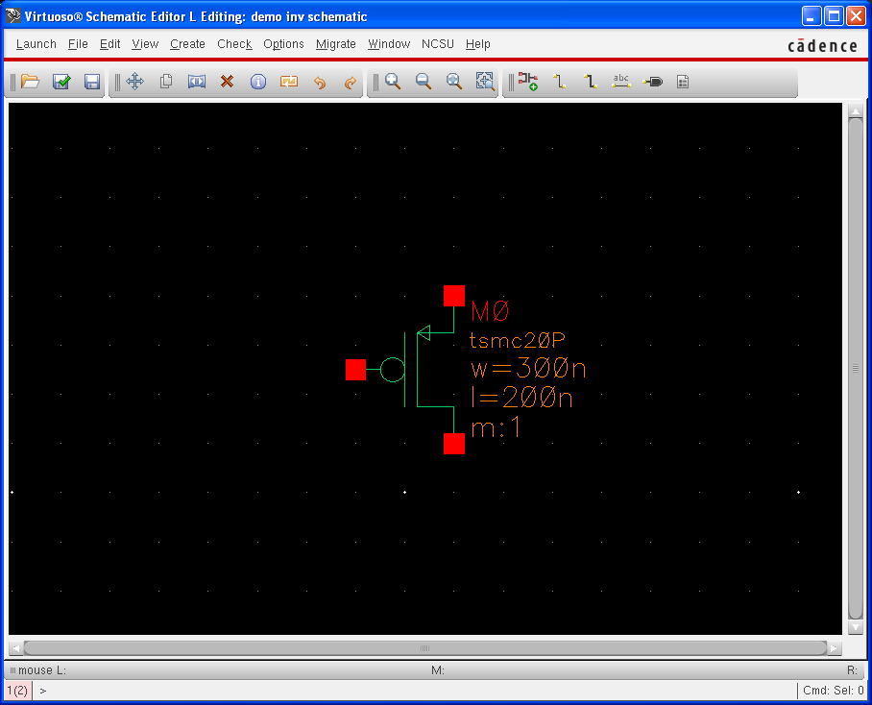
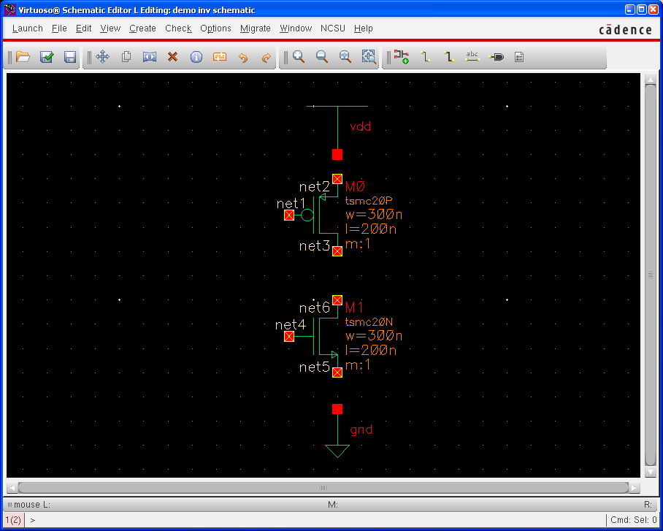
ii. Add instances – nmos, vdd, and gnd

Slide 7
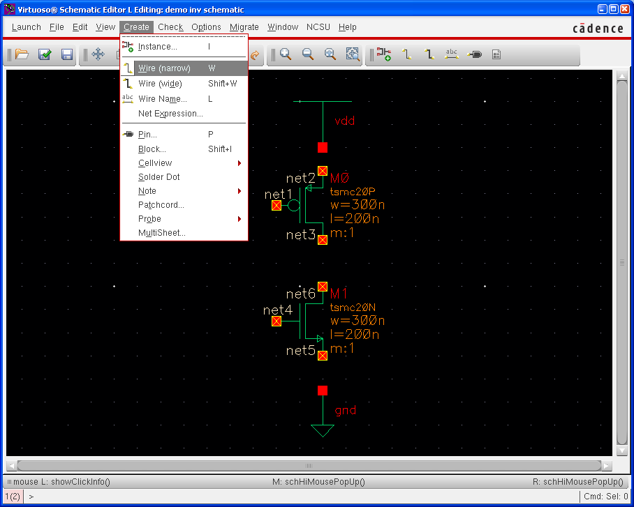
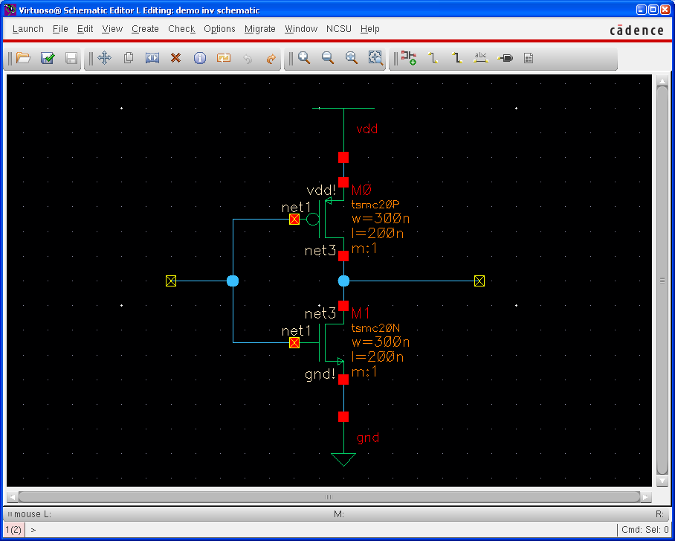
iii.
Add wires: Create → Wire

Slide 8
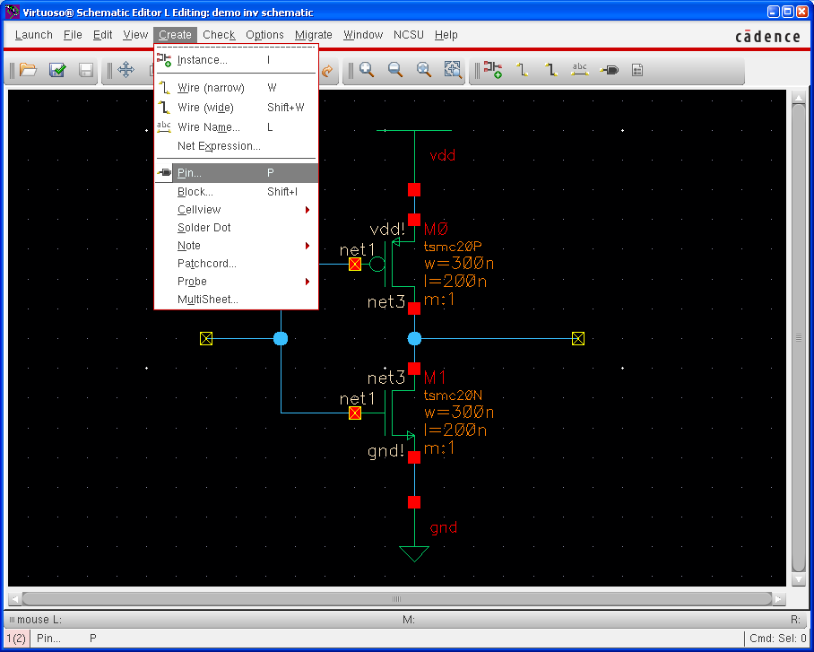
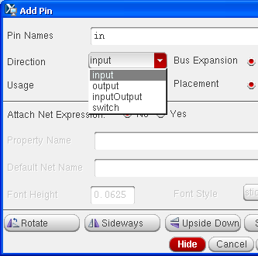
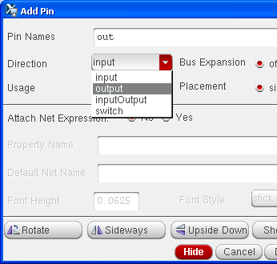
iv. Add pins: Create → Pin
We have for different types of direction. For schematics, we only use two types, input and output. InputOutput type is for supply changes, and it is necessary only for layout. We will discuss about this later.

Slide 9
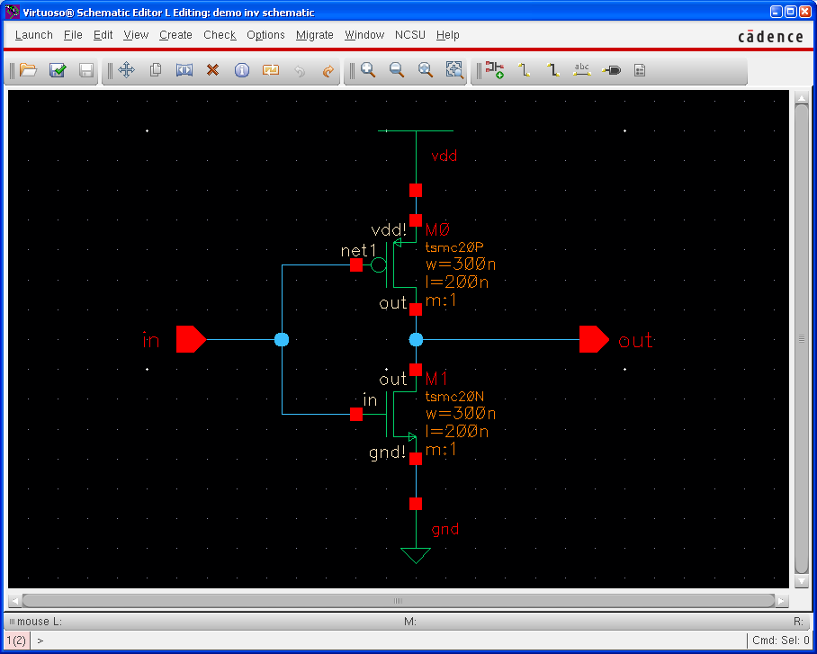
Now, we completed a schematic design. Let’s move on the next phase.

Slide 10
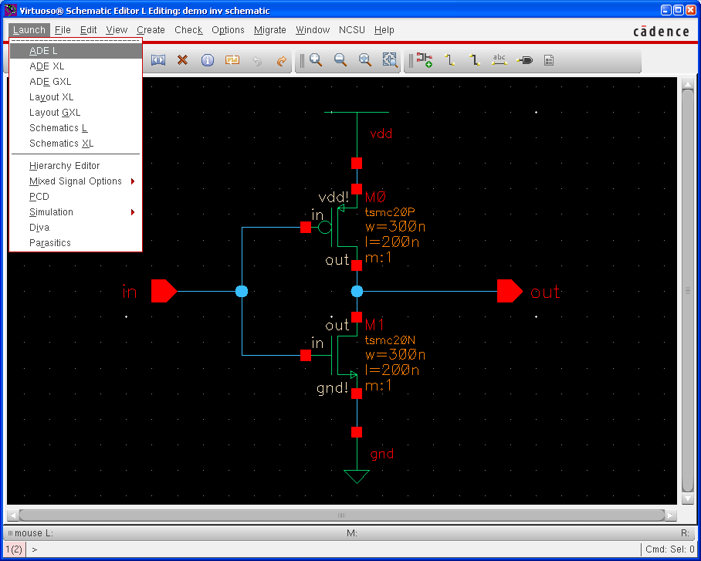
Run Spectre simulation
We will run spectre simulation. This section is for both schematics and layouts. I will show an example for a schematic. You can do the same thing for a layout.
A. Launch ADE (Analog Design Environment) L
Launch → ADE L

Slide 11
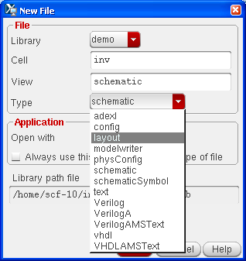
4. Layout
It’s time to draw layout. Schematics are for verifying your design very roughly. They don’t consider physical features like parasitic capacitances. After determining your design variables by schematics, you need to draw layouts.
Design flow of layouts is very similar to one of schematics, but it has additional step which is LVS check. It is for check if your layout is identical to the schematic or not. Hence, this step is very important. If your logic doesn’t pass this step, you may lose significant points for that.
A. Create a layout

Slide 12
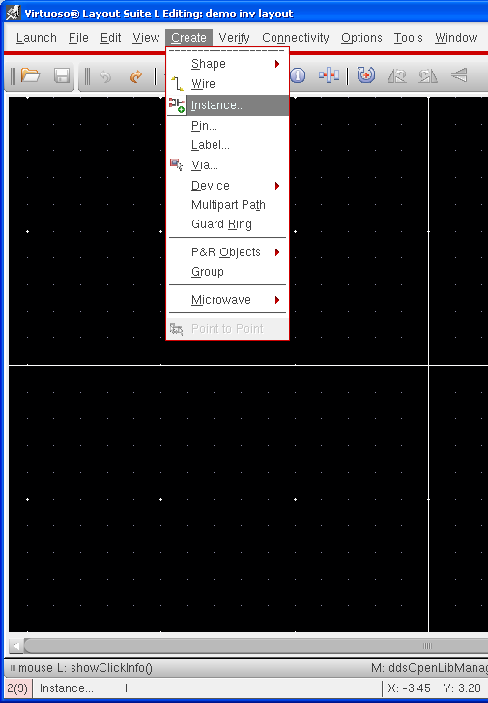
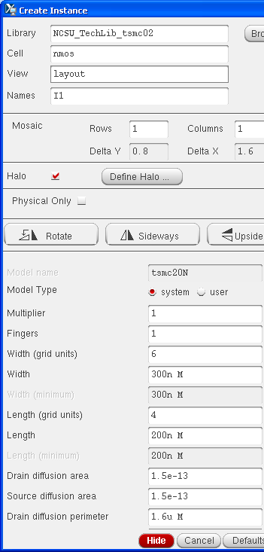
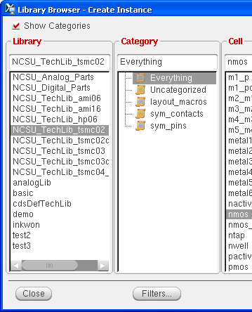
B. Add an instance - nmos
You can modify width of transistors.

Slide 13
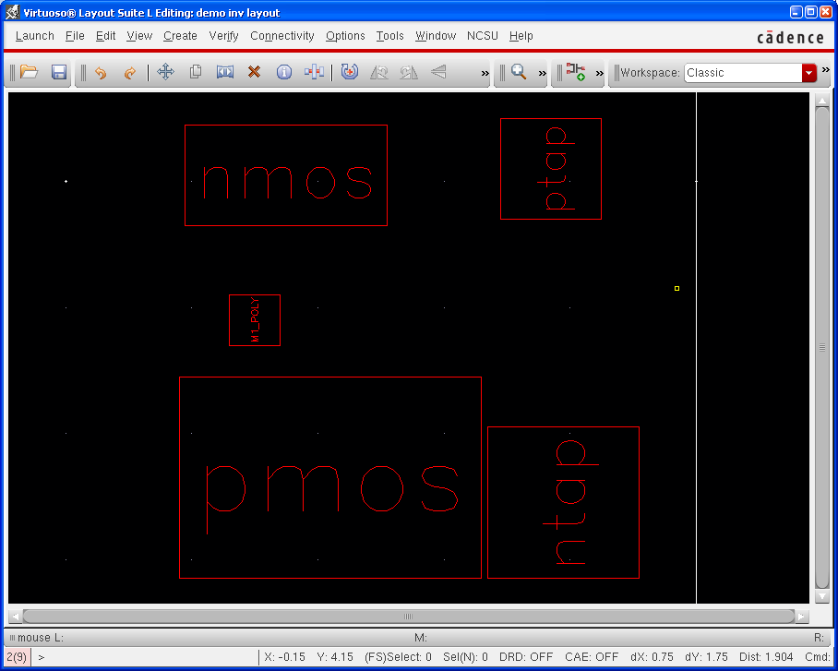
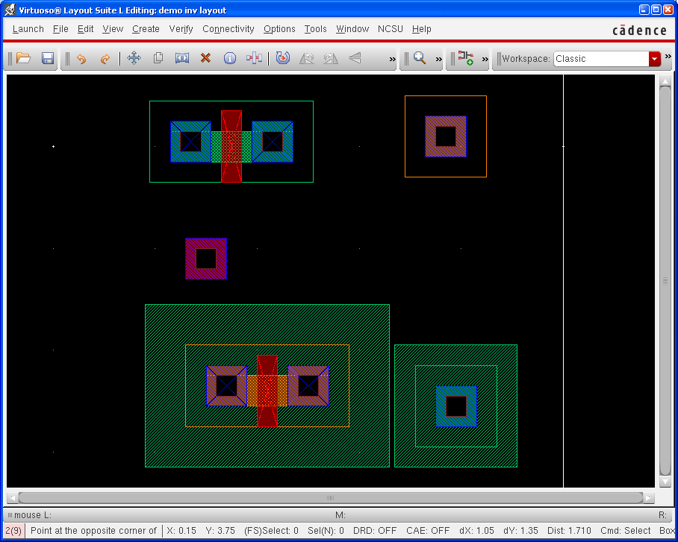
C. Add more instances – pmos, ptap, ntap, and m1_ploy
You can select alternate view of a layout. Try ‘Shift + f’ and ‘Ctrl + f’.

Slide 14
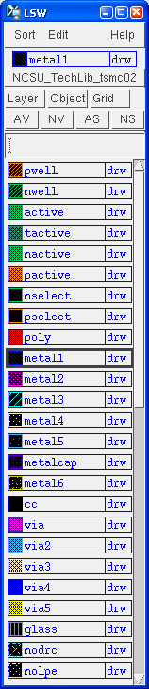
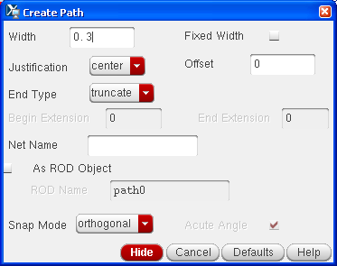
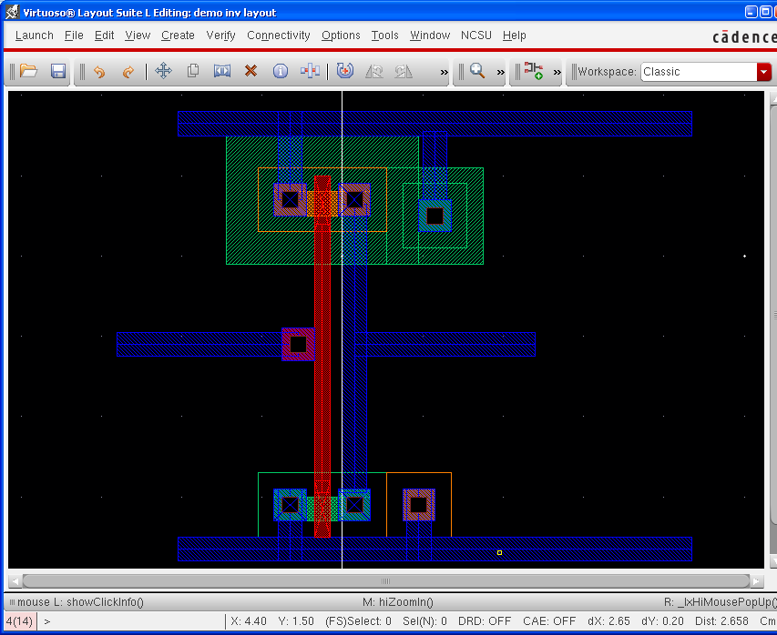
D. Draw metal1
There are few ways for drawing metal, but I recommend you use ‘path’. It’s quite convenience than others.
Create → Shape → Path
First of all, you should select metal1 on LSW window. Default width for metal1 is 0.3, which means 300nm (3 λ). You can draw metal layer simply by clicking

Slide 15
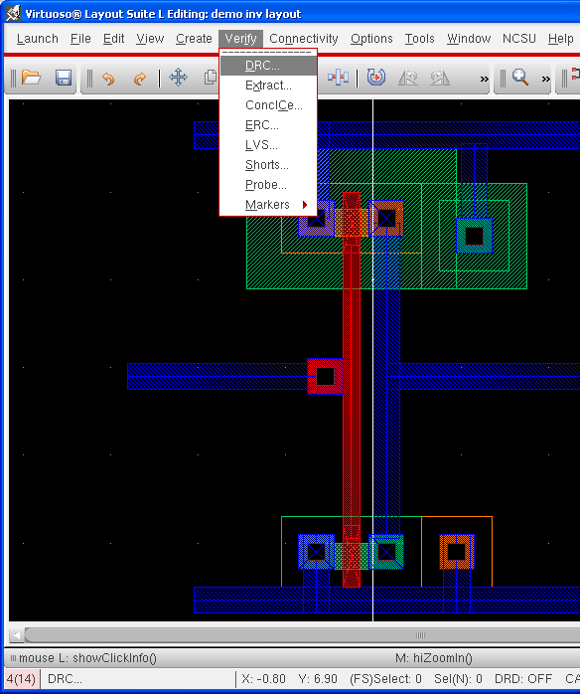
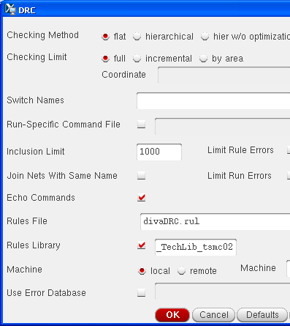
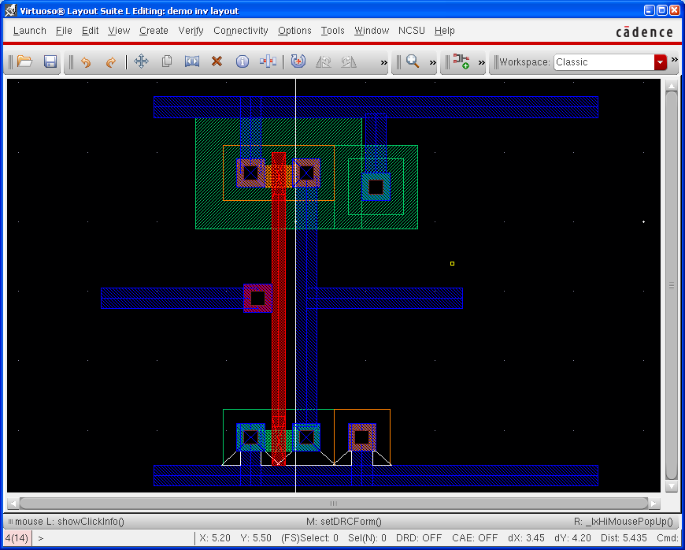
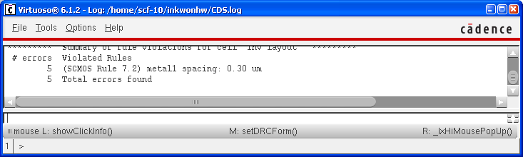
E. Run DRC
This step checks if your layout follows design rules.
Verify → DRC

Slide 16
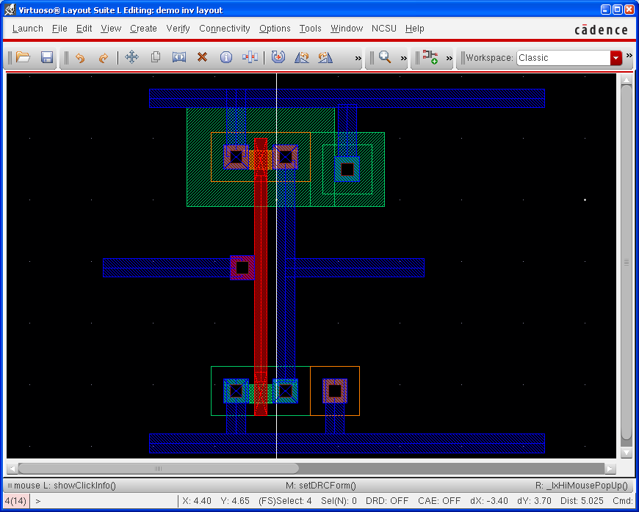
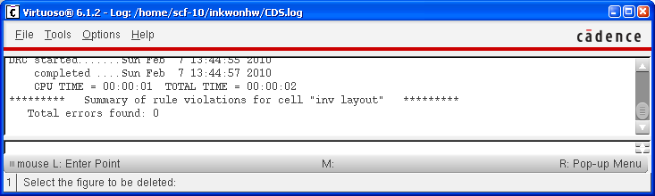
We have five errors. It is because a gnd metal layer is too close to an nmos transistor. After modifying layout, run DRC again.
There is no error!!

Slide 17
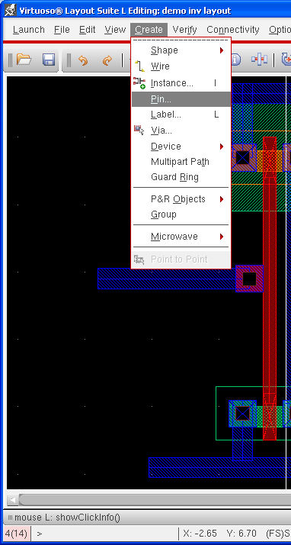
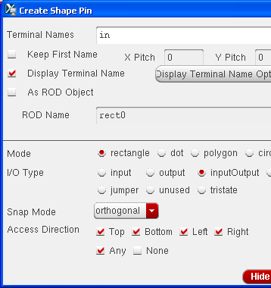
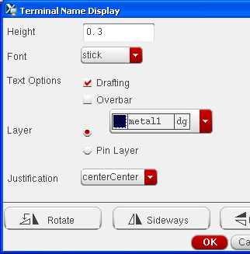
F. Add pins
We had two pins on a schematic, which are ‘in’ and ‘out’. Pins are for assigning signals to physical device, so we assign voltage level of gnd and vdd by using pins. Hence, we have 4 pins for the layout, which are ‘in’, ‘out’, ‘gnd!’, and ‘vdd!’.
Create → Pin
Check ‘Display Terminal Name’ if you want to see pin name on the layout.
Click ‘Display Terminal Option

Slide 18
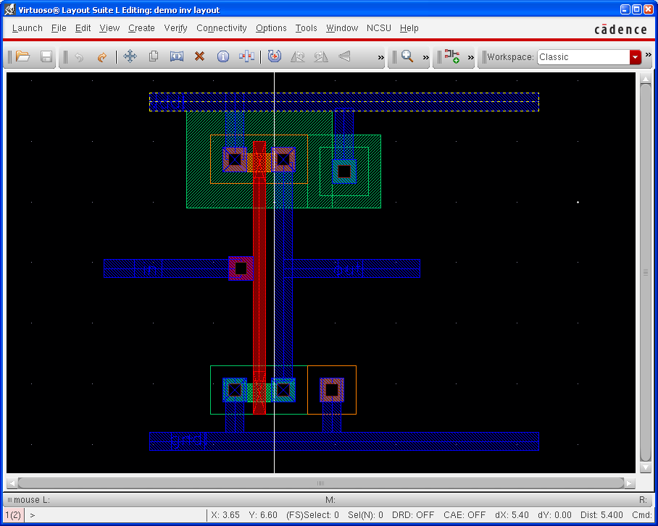

Slide 19
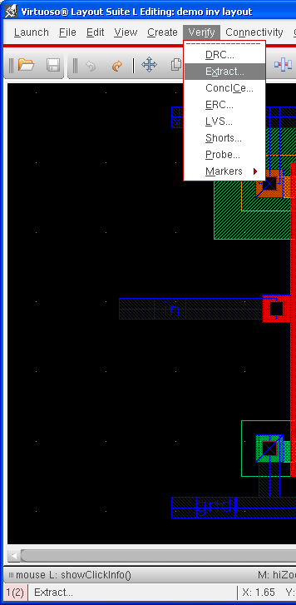
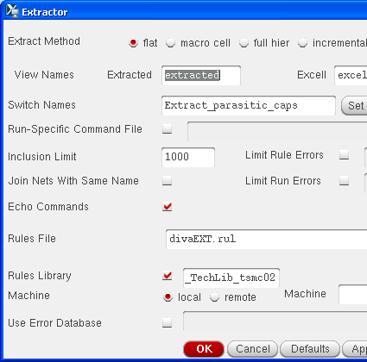
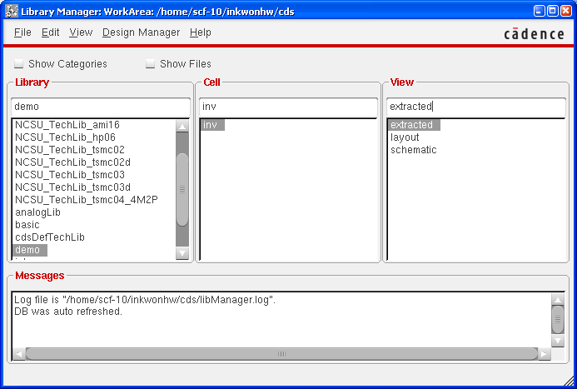
G. Extract
A layout is just a picture. If you need to run simulation using the layout, you should convert it to
the other format. It is done by extracting. It’s something like compiling a code.
Select ‘Extract_parastic_cap’ as a switch name, otherwise your extracted design won’t have parasitic capacitances.

Slide 20
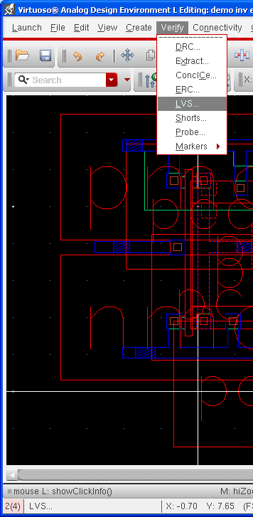
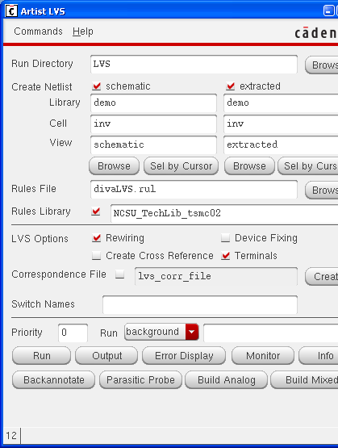
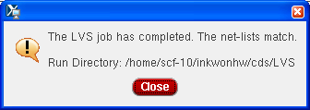
H. Run LVS
As I mentioned before, this step is very important for your grading. More complicated design,
more time will be required for debugging LVS.
Verify → LVS
Keep in mind. You SHOULD compare your schematic with EXTRACTED.
I hope all of you will see the following window.
If there are errors, you can check the results by clicking ‘Output’ button. ‘Error Display’ also might be helpful.

Slide 21
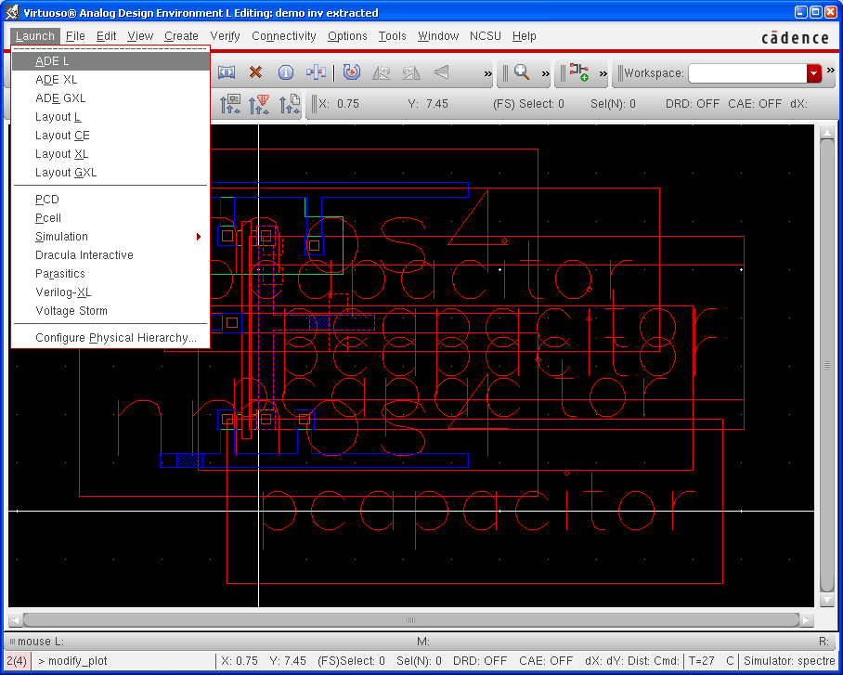
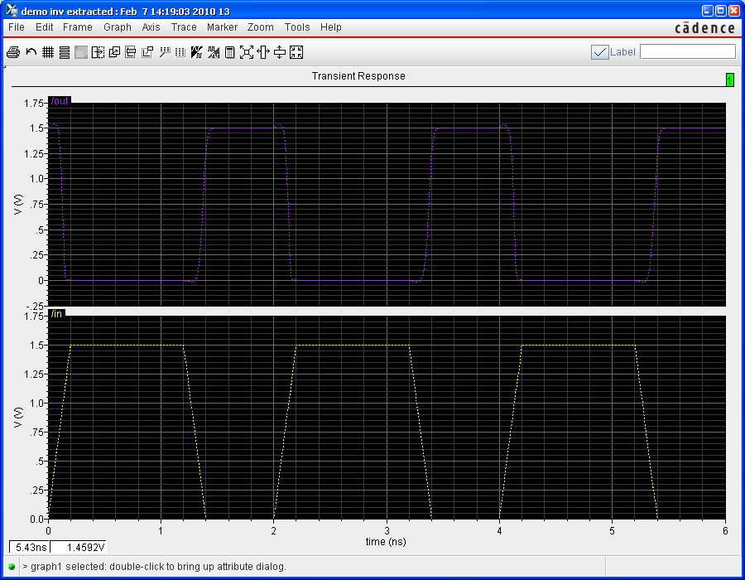
I. Run Spectre simulation
It is same as schematics. Go to step ‘4. Run Spectre simulation’.
Congratulations!!
You followed all steps I prepared. Let’s do the same thing for more complicated designs.

